Slide 1


E-commerce Dashboard Insights
Analyzing Customer Behavior, Sales Performance, and Product Trends
Jagadeesh Pondara

Slide 2

Agenda
Introduction
Customer Demographics and Behavior
Gender Distribution & Customer Location
TimeLine chart
Number of order over time
Stock Levels by Category
Retention Rate
Conclusion

Slide 3

Introduction
Objective:
The goal of this dashboard is to provide comprehensive insights into various aspects of our e-commerce operations. By analyzing key metrics, we aim to:
Understand customer demographics and behavior.
Examine sales trends over time.
Evaluate product performance and stock levels.
Assess customer retention through cohort analysis

Slide 4


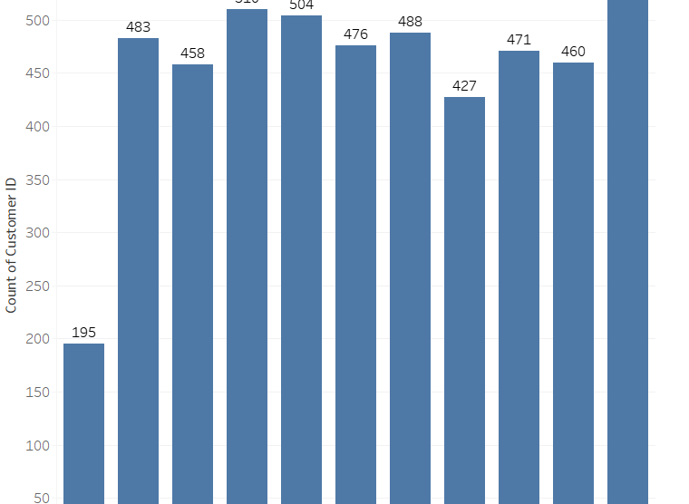

Customer Demographics & Behavior
Highest Customer Count in 65+ Age Group:
The 65+ age group has the highest number of customers, with a count of 528, indicating a strong presence of senior customers.
Consistent Customer Distribution Across Ages 20-60:
There is a relatively consistent customer count across the age groups 20 to 60, with counts ranging between 458 and 504, suggesting a balanced age distribution in these segments.

Slide 5
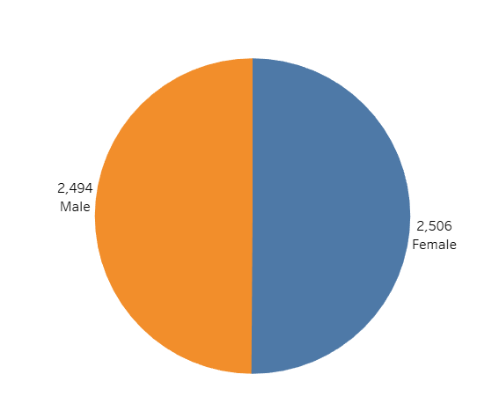
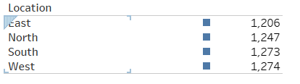
Gender Distribution
Customer Location
Gender Distribution
Balanced Demographic: The gender distribution is nearly equal, with 2,506 female and 2,494 male customers.
Implication: Marketing strategies should be inclusive, targeting both genders equally to maximize engagement.
Customer Location
Geographical Spread: Customers are fairly evenly distributed across all regions: East (1,206), North (1,247), South (1,273), and West (1,274).
Implication: Regional marketing campaigns can be evenly distributed, ensuring all areas are targeted equally for promotions and product launches.

Slide 6
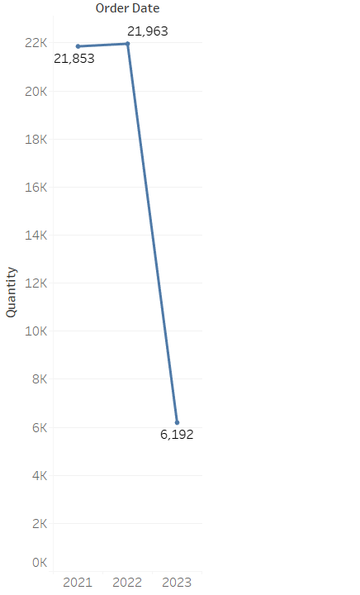
TimeLine chart – Year wise Qty
Significant Drop in Orders in 2023:
There is a dramatic decrease in the
quantity of orders from 21,963 in 2022 to 6,192
in 2023, indicating a significant reduction in customer activity or demand.
Stable Orders in 2021 and 2022:
The quantity of orders remained relatively
stable between
2021 (21,853) and 2022 (21,963),
before the sharp decline in 2023.

Slide 7
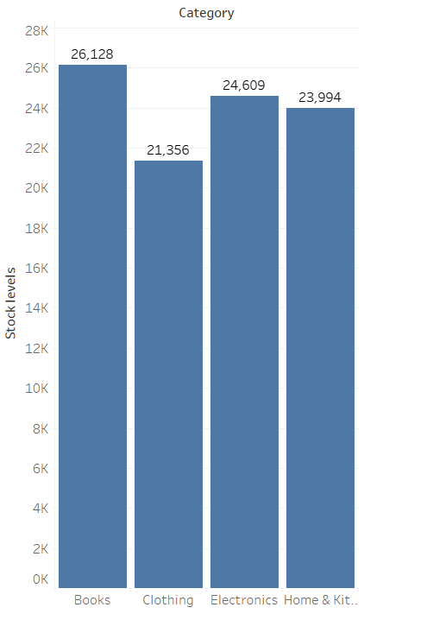
Stock Levels by Category
Books has the highest stocks in Category followed by Electronics and Home & Kitchen Appliances.
In Future, inventory stocks for books can be increased in-order to get the good amount of Sales Quantity.

Slide 8
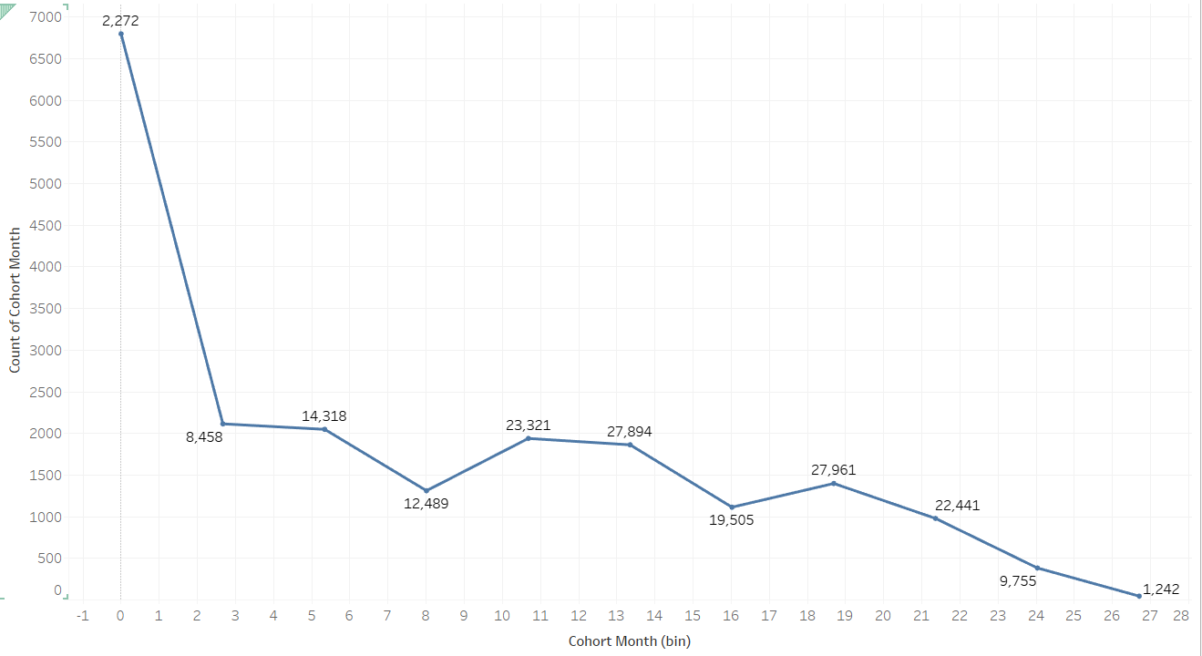
Retention Rates
Initial Decline in Cohort Count:
The chart shows a steep decline in the count of cohort months from bin 0 to bin 1. This indicates a significant drop-off in cohort engagement or retention after the initial period.
Fluctuations in Cohort Count Over Time:
Following the initial decline, the cohort count experiences several fluctuations,
with peaks at bins 11, 13, and 17. Despite these peaks, there is a general downward trend towards the end,
reaching a low of 1242 in bin 27. This suggests varying levels of cohort engagement or retention over time, with certain periods showing higher engagement before declining again.
S.

Slide 9
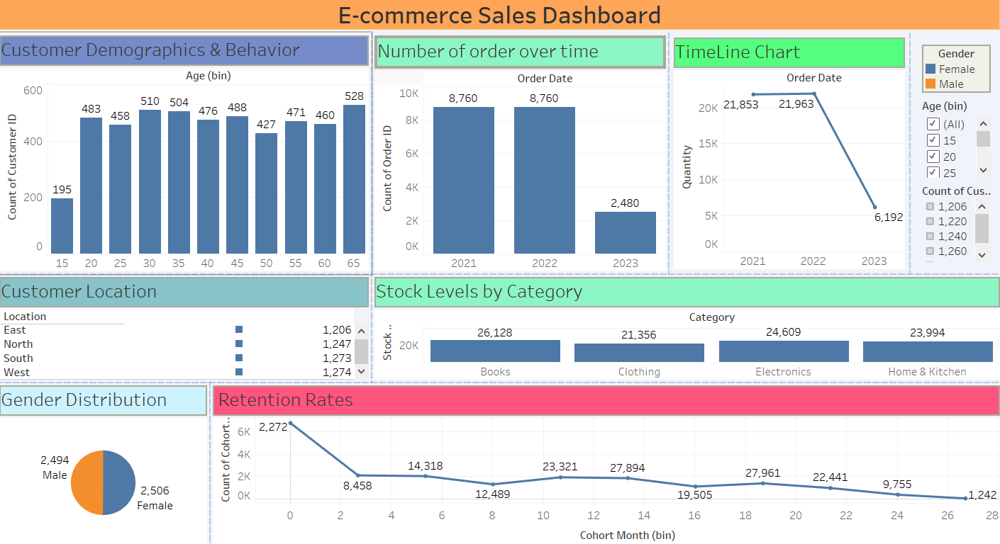
Final Sales Dashboard
S.

Slide 10
Conclusion
).
1. Customer Demographics:
Most customers are aged 25-65, with a peak at 65 years (528 customers), and the fewest in the 15-year bin (195).
2. Order Trends and Gender Distribution:
Orders were steady in 2021-2022 (8,760) but dropped in 2023 (2,480).
Gender distribution is nearly equal, with 2,506 females and 2,494 males.
3. Retention and Stock Levels: Retention rates drop sharply initially, then fluctuate.
Highest stock levels are in books (26,128), followed by electronics, home & kitchen, and clothing.
4. Customer Location:
The distribution of customers across regions is relatively even, with the West having the highest count (1,274) and the East the lowest (1,206)
5. Timeline Chart: Order quantities were high in 2021 and 2022 (around 21,853 and 21,963) but significantly decreased in 2023 (6,192), indicating a recent drop in sales activity.
6. Stock Levels by Category: Among product categories, books have the highest stock levels (26,128), indicating either a high demand that is met with adequate supply or potential overstock. This is followed by electronics (24,609), home & kitchen (23,994), and clothing (21,356).
pondarajagadeesh98@gmail.com
7989346853

